Slide 1

Road Fighter
Laboratory 044157: Final project
Timothy Aknine
Ruben Fitoussi
Tutor: Ilan

Slide 2


Project design
Requirement
Creativity
Travel at a variant speed and move left and right on a straight track.
Uniform track with no obstacles, only the background moves.
Implementation of yellow and red cars.
Additional points awarded at regular intervals. Significant bonus points awarded for refueling.
Fuel decrease at a constant rate.
When colliding with a car or the sides of the track, the car explodes, and an additional delay time equivalent to 5 fuel units is added.
Collision sounds and victory sounds.
Car's current position
Turbo
3 Maps
8 characters
Music and animation Win/Loose
High Score
Road mooving left/right
Leans on collision, possibility to come back, spinning otherwise

Slide 3
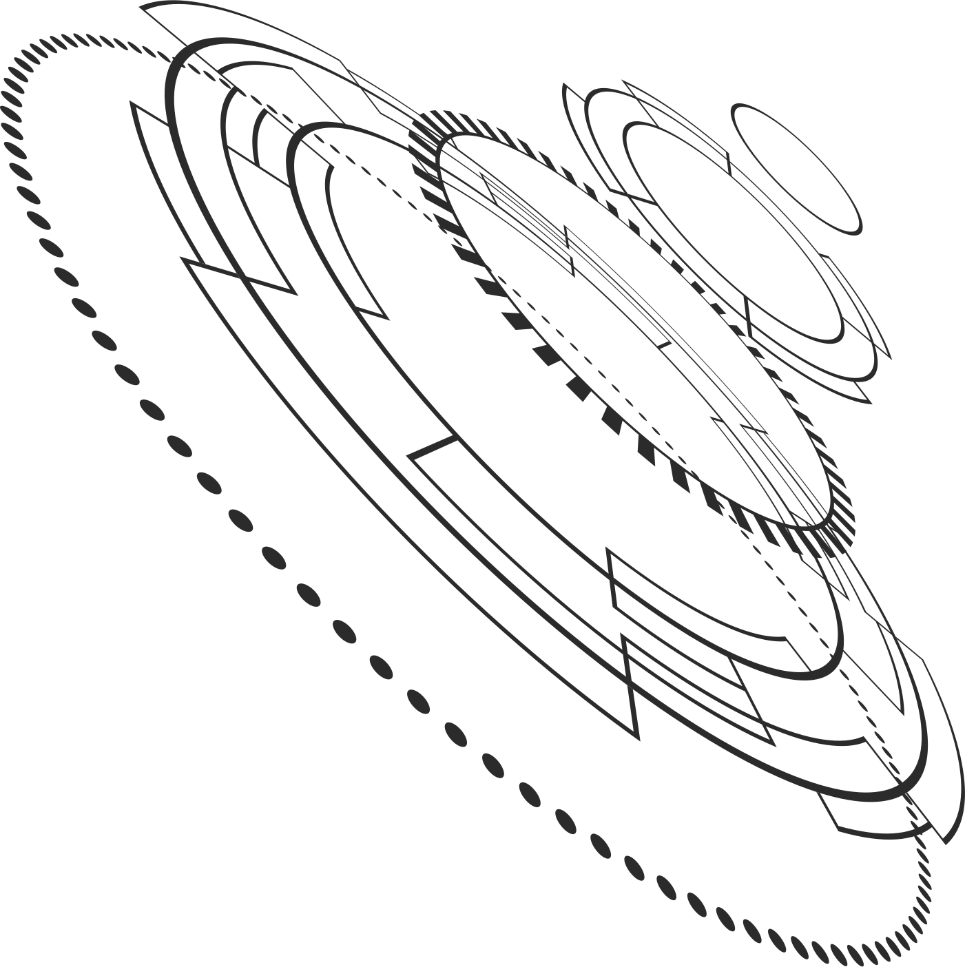



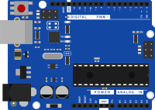

System interfaces
VGA
Key & switches
DE-10
Speakers

Slide 4

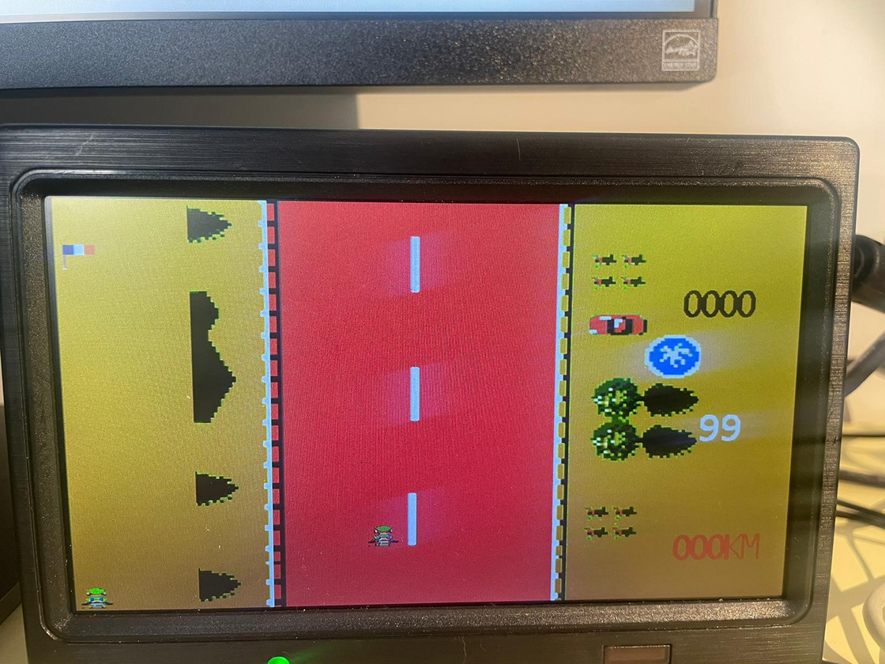
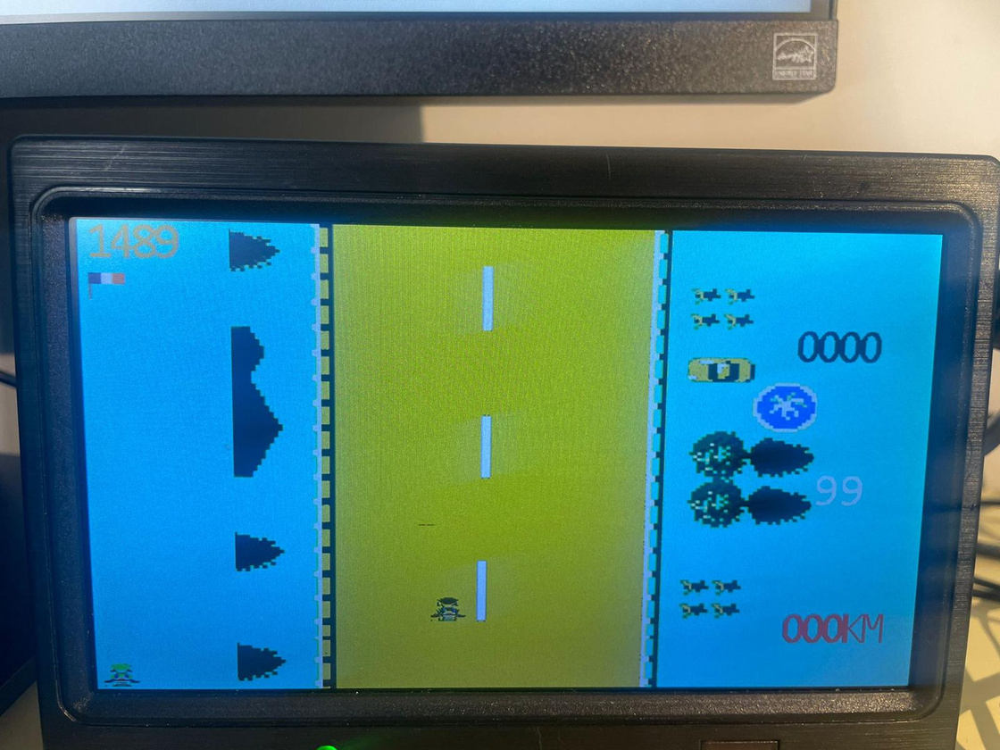


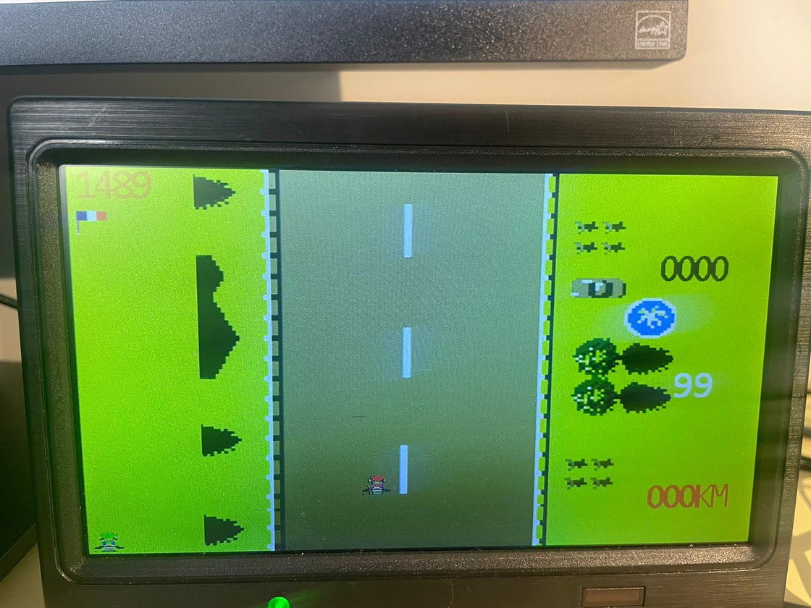

Start
Meadow
Lava
Sea
3 maps
8 characters

Slide 5
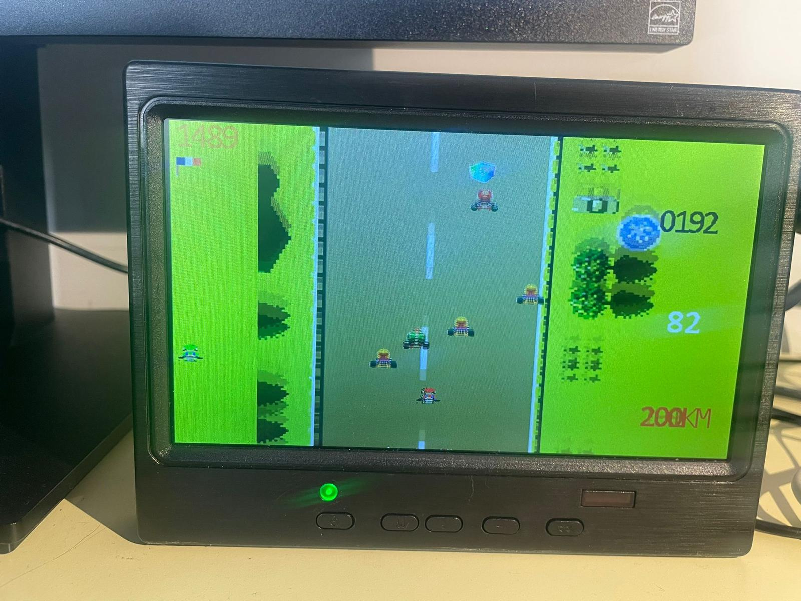





Gameplay
High Score
Mystery Box: Fuel
MARIO: Red Car
SCORE
WARIO: Yellow Car
FUEL
Player's current position
BOWSER: Blue Car
SPEED
Luigi: Player

Slide 6
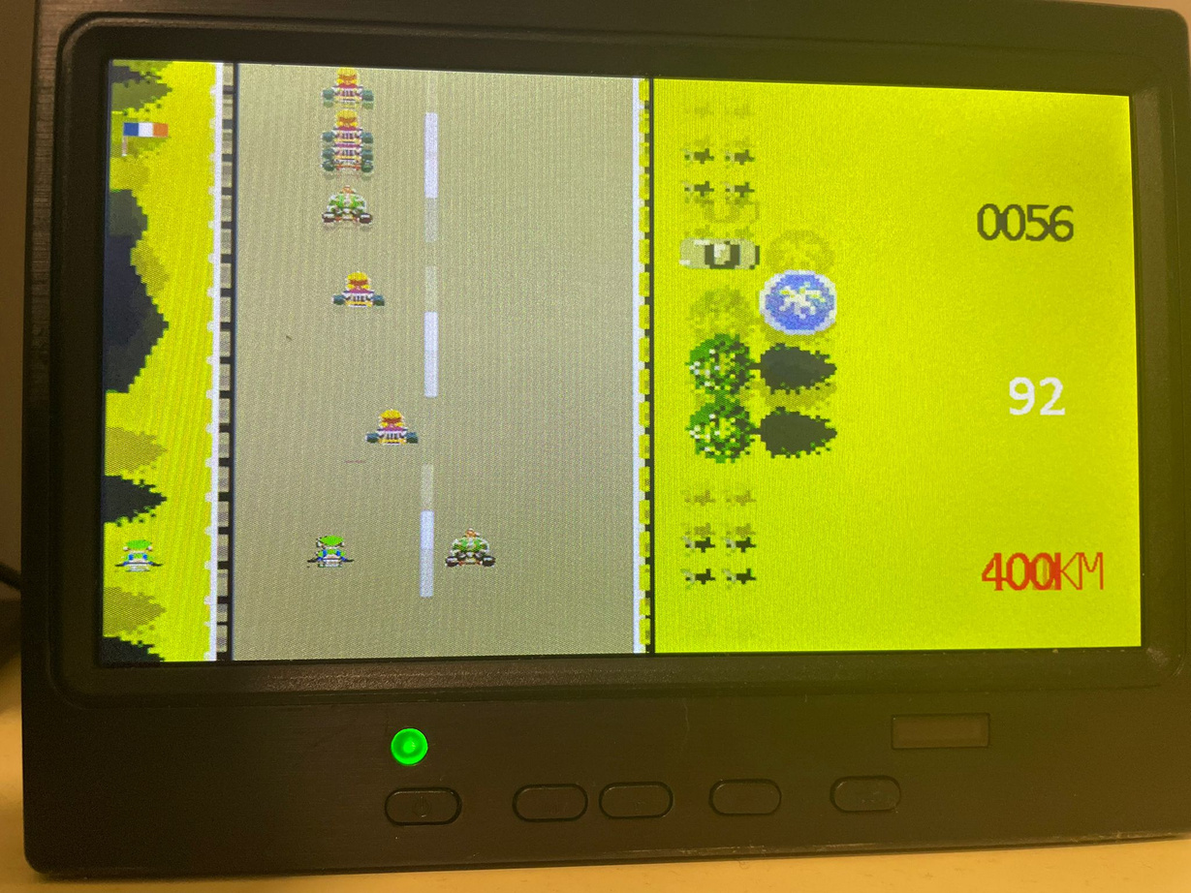
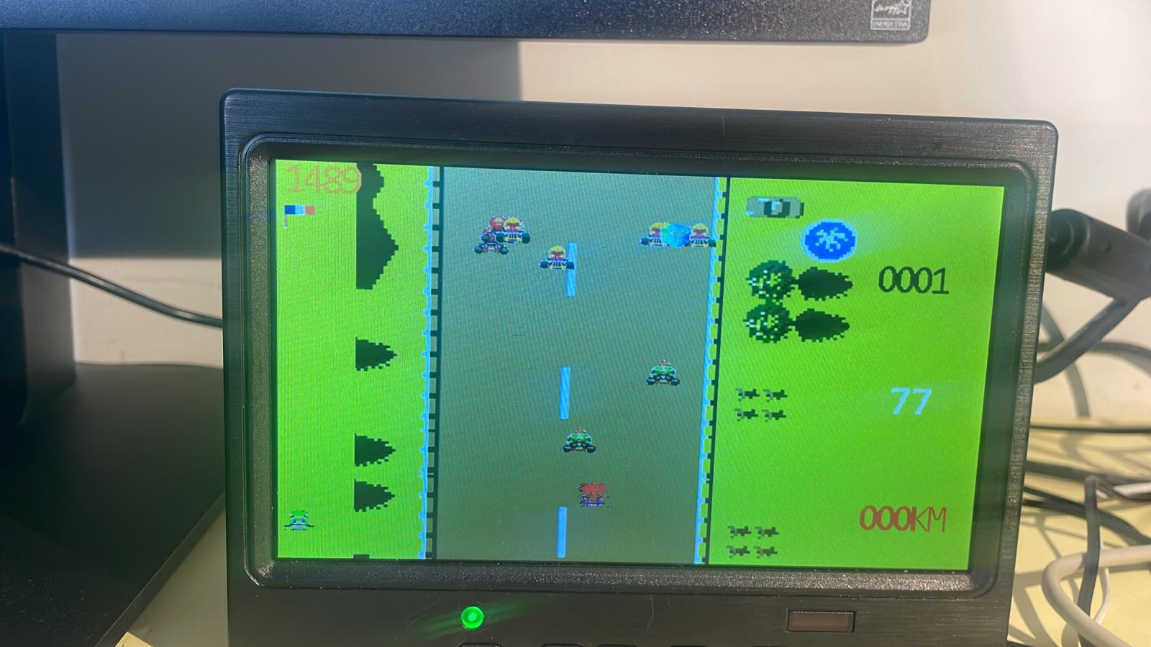
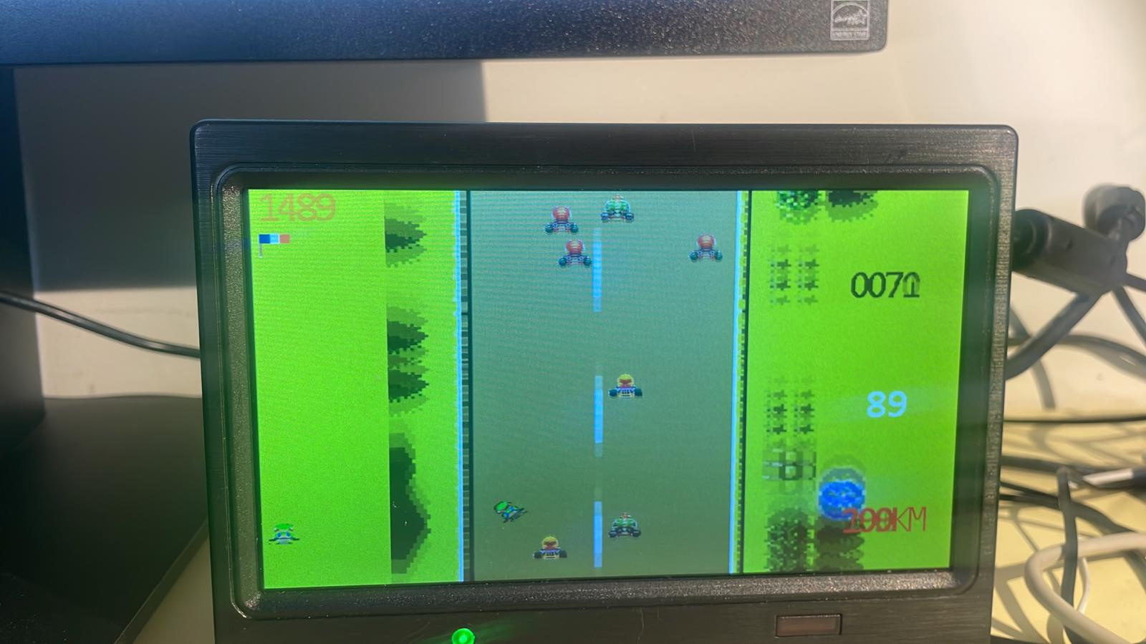
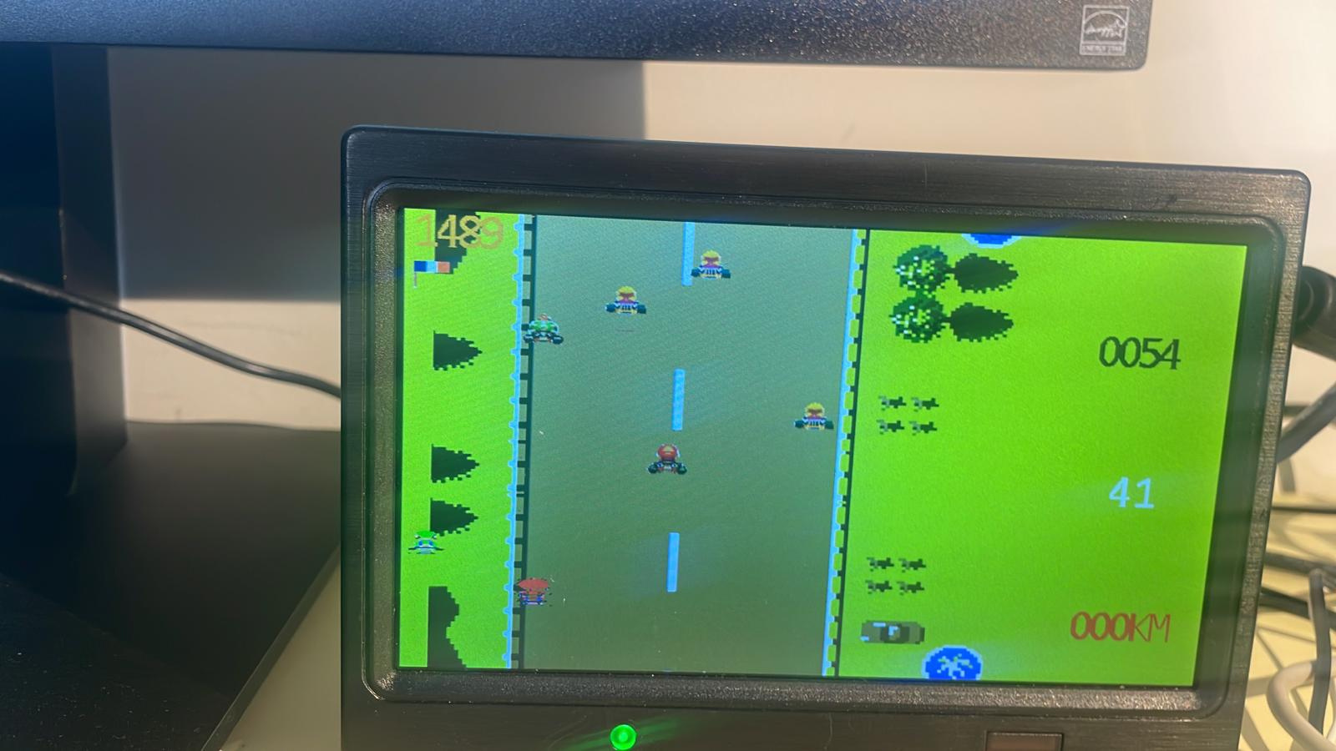
Explosion
Turbo
Collision Bowser
Spin
Reaching Boundaries

Slide 7

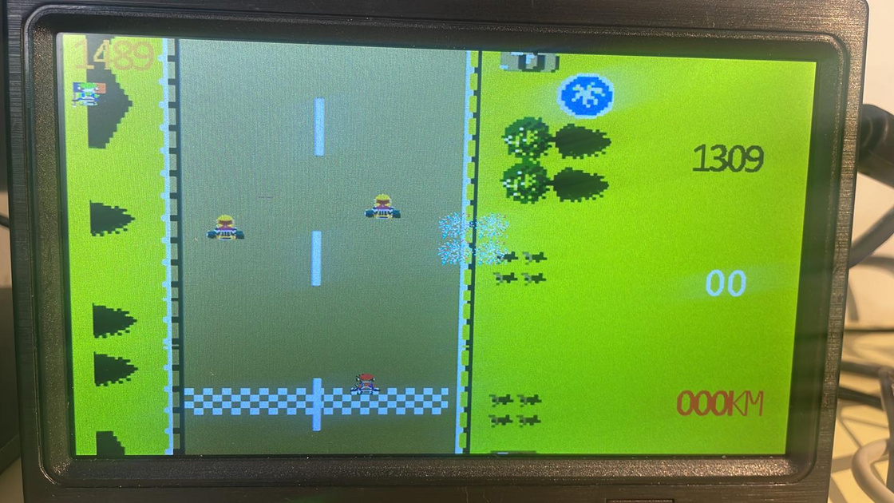
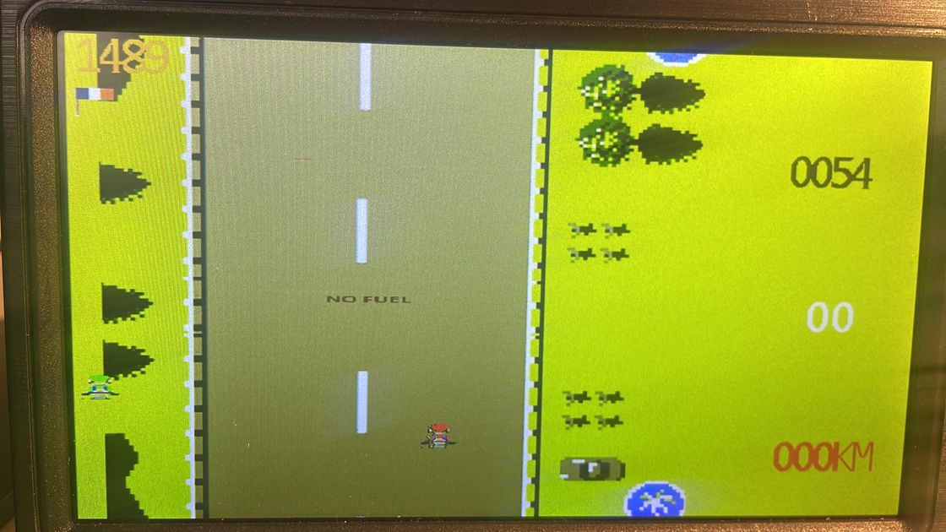

End of Game
Winner
Looser

Slide 8

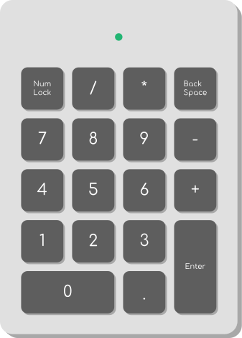



User instructions
Gaz
Switch Map
Left
Switch character
Brake
Right

Slide 9
KBD
Luigi
Car Fuel
Random
Car Static
Car Dynamic
Object
MUX
VGA controller
Car Explosive
Speed Controller
Background
Speed
One Sec Counter
Fuel
Score
SEG7
Schema
Game Controller
Sound

Slide 10
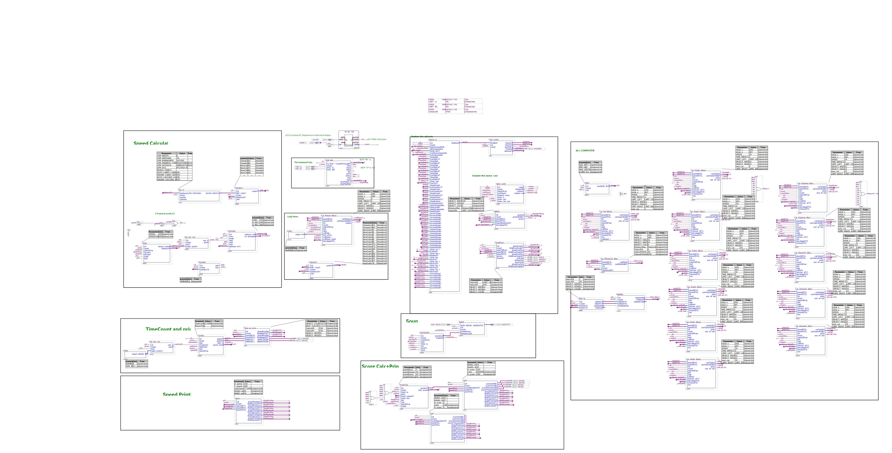
Top-level hierarchy diagram
CLK
Speed Calculator
KBD
Luigi Move
VGA
Game controller
Sound
Time count and Print
Speed Print
Computer car Generator
Score Calculator and Print

Slide 11
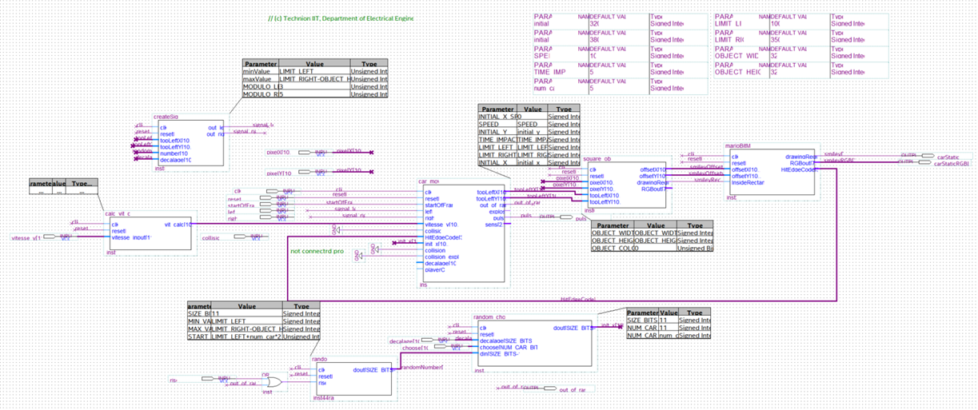
DynamicCar

Slide 12
Rise
Signal left/Right
Random
Choosen
Dynamic Car
Random choose
Shift
Speed
Calculate speed
RGB
Car Move
Object
Pulse

Slide 13
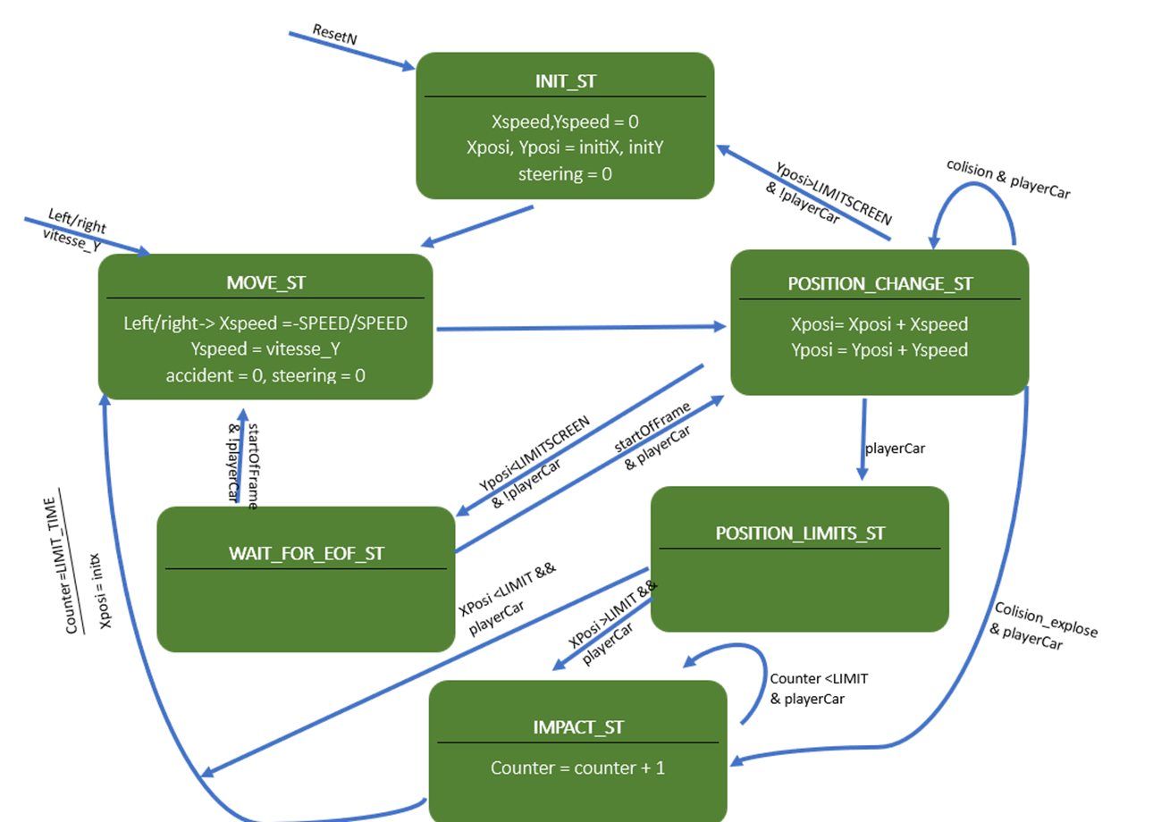
State machine description

Slide 14
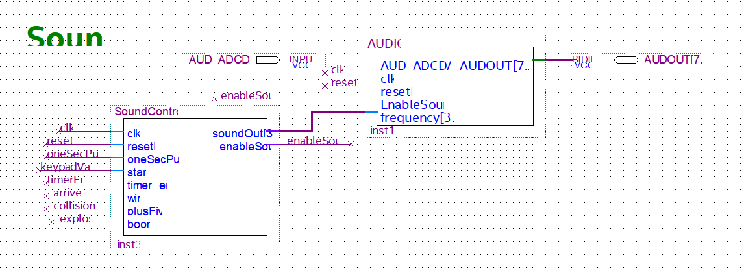
Sound Controller

Slide 15

State machine description
resetN
TIMEREND3
TIMEREND2
WIN2
WIN3
IDLE
oneSecPulse
oneSecPulse
timerEnd
win
oneSecPulse
TIMEREND1
--------------
counter++
oneSecPulse
oneSecPulse
WIN1
-----------------
counter++
oneSecPulse
oneSecPulse
oneSecPulse
plusFive
boom
start&& !startTriggered
oneSecPulse
FIVE
BOOM
(if counter==3)
(if counter==3)
START
----------------
startTriggered=1

Slide 16
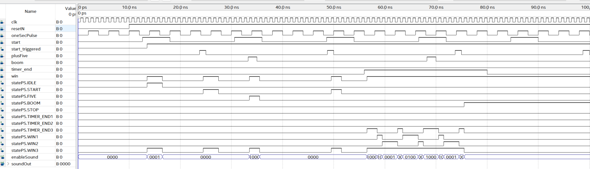
Simulation
IDLE
START
FIVE
BOOM
FIVE
WIN1,WIN2,WIN3 X3
STOP

Slide 17
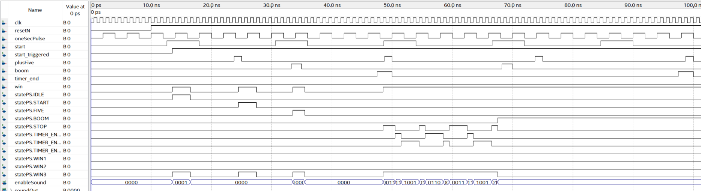
Simulation
IDLE
START
FIVE
BOOM
TIMEREND1,2,3 X3
STOP

Slide 18
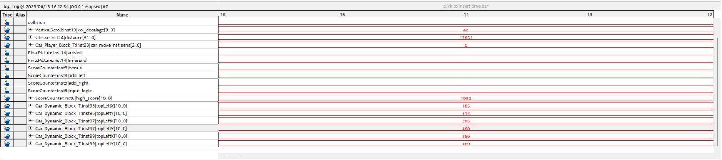
SIGNAL TAP
Characters' position can be monitored dynamically for both vertical and horizontal movement.
High score and increasing distance
Counter signals indicate proper activation upon point collection.

Slide 19

Conclusion
Highly interesting and challenging
We learned a lot and developed an understanding of the correct approach
We had a lot of fun!
Thank
you!

